Slide 1
Title: Understanding Linear Algebra for Engineers Subtitle: With Application to PCA in Data Reduction Presented by: Jitendra Kumar

Slide 2
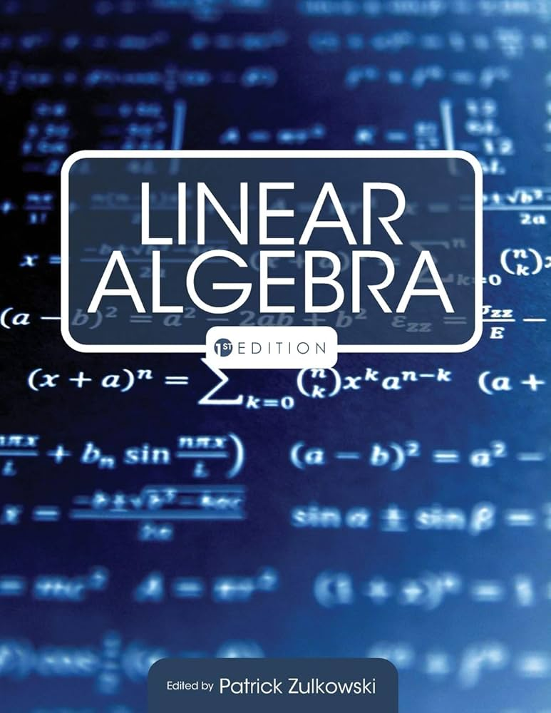
What is Linear Algebra?
Linear Algebra is the branch of mathematics dealing with vector spaces and linear mappings between them. It’s the foundation of machine learning, graphics, and data science.

Slide 3
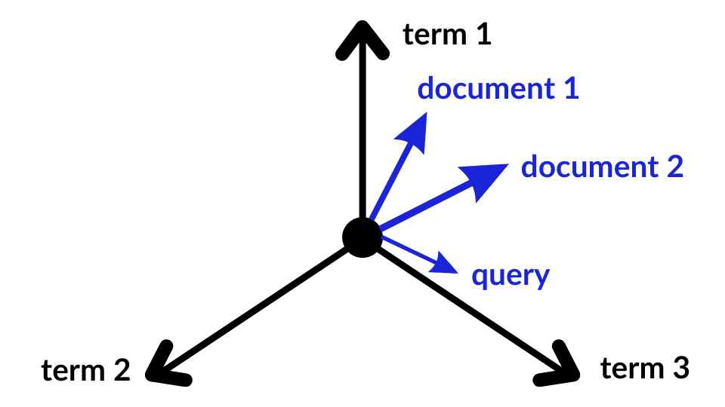
Vector Spaces
A vector space is a collection of vectors that can be added together and multiplied by scalars. Example: 2D and 3D coordinates (like [3, 4] or [1, 0, -2]).

Slide 4
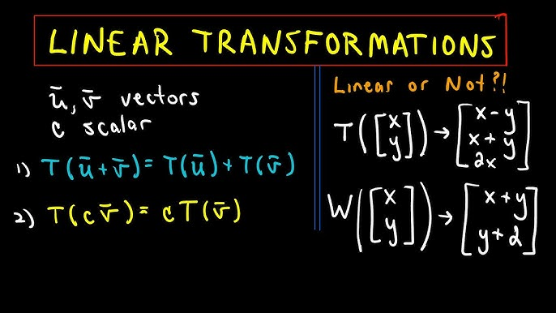
Linear Transformations
These are functions that preserve vector addition and scalar multiplication. Example: Rotation, scaling, reflection.

Slide 5
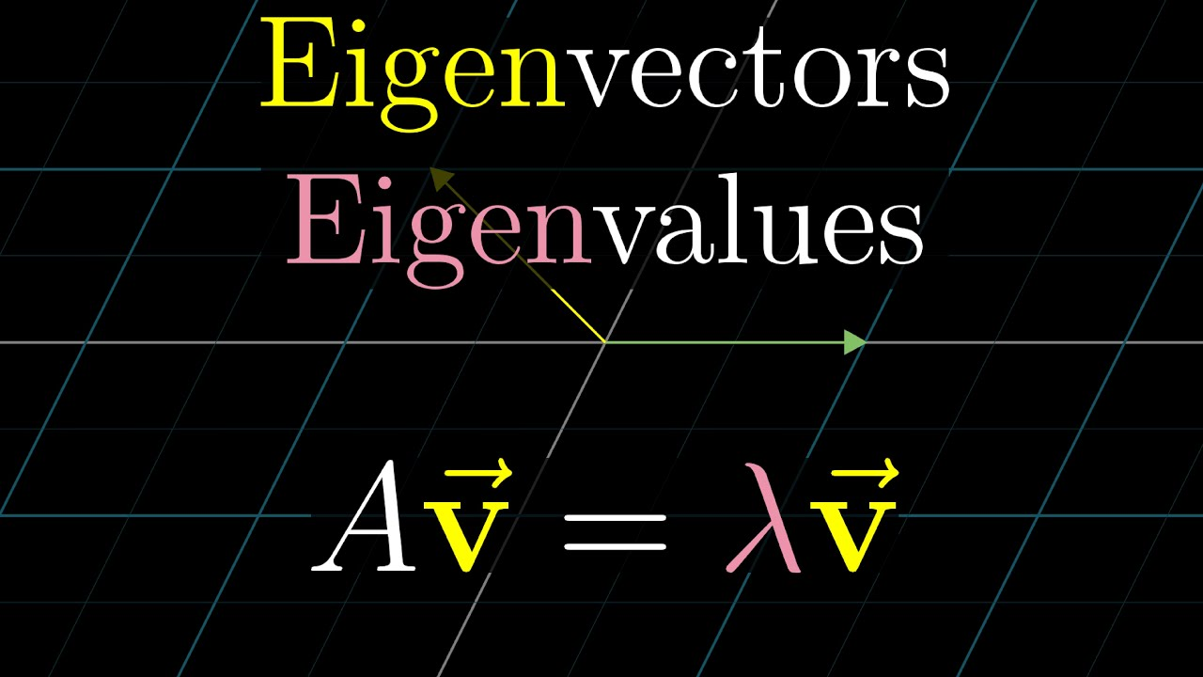
Eigenvalues and Eigenvectors
An eigenvector is a vector that doesn’t change direction under a transformation. Eigenvalue tells you how much it stretches or shrinks. Equation: A * v = λ * v

Slide 6
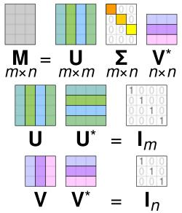
Singular Value Decomposition (SVD)
Breaks any matrix into 3 parts: A = U Σ Vᵀ. Used in image compression, noise reduction, etc.

Slide 7
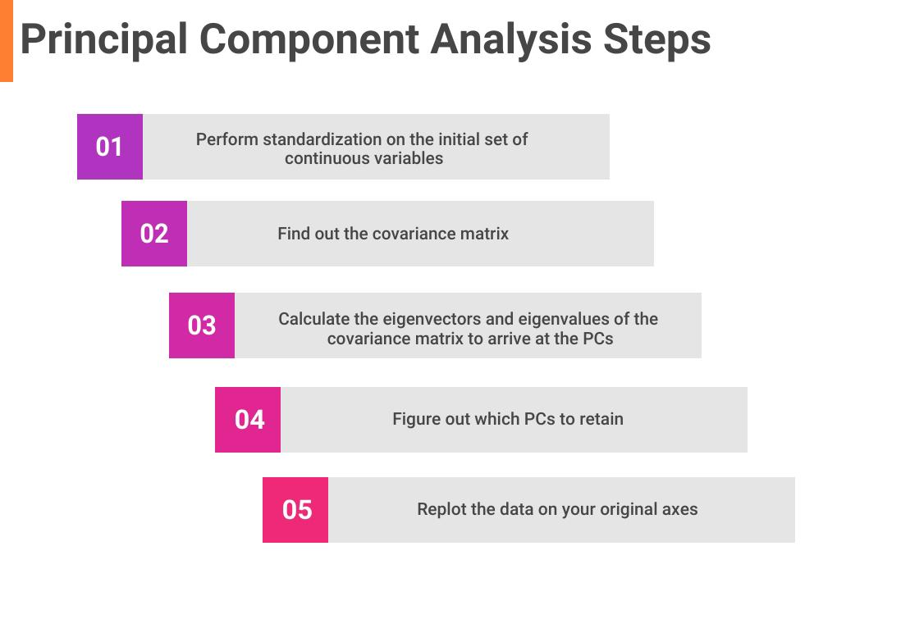
Engineering Application – PCA
Principal Component Analysis (PCA) reduces the number of features in large data. Uses eigenvectors of the covariance matrix to find the most important directions. Helpful in image compression, face recognition, etc.

Slide 8
Worked-Out Example
Find the eigenvalues and eigenvectors of this matrix A = \begin{bmatrix} 2 & 1 \\ 1 & 2 \end{bmatrix} Solution: Characteristic equation: det(A – λI) = 0 Eigenvalues: λ = 3, 1 Corresponding eigenvectors: For λ = 3: [1, 1] For λ = 1: [1, -1]

Slide 9
Summary
Vector spaces help organize data Linear transformations are everywhere in engineering Eigenvalues are key to understanding transformations PCA is a real-world use case using linear algebra

